Slide 1
Titanic - Machine Learning from Disaster
Team 7 - Members: Hayes Justin Landry and Jakob West
Course Information: CS3820-002
Professor: Dr. Moin
TA: Himon Thakur

Slide 2
Topic: Titanic Survival Prediction
Customer and End-User: Kaggle, data scientists; historians
Problem Statement: Build a Machine Learning model and compete in a Data Competition to predict who survived vs who did not survive the Titanic using historical data.
Value Proposition: Contributes to work done on Kaggle; adds to leaderboard; to help the data science community (Data science enthusiasts and students)

Slide 3
Related Work and Unique Selling Point
Related Work: Email, Cancer screenings, Stock Markets, Sports
Unique Selling Point (USP): Individual contributions
Reuse of Existing Work: experimenting with ideas from other Kaggle contributors

Slide 4
Work Breakdown Structure
Individual Tasks
Data Understanding & Preprocessing
Feature Engineering (Justin)
Model Selection & Training (Jakob)
Group Tasks
Evaluation and Reporting

Slide 5
Open-Source Consideration
We are looking into open source depending on rules set by Kaggle.com
MIT license is our first choice

Slide 6
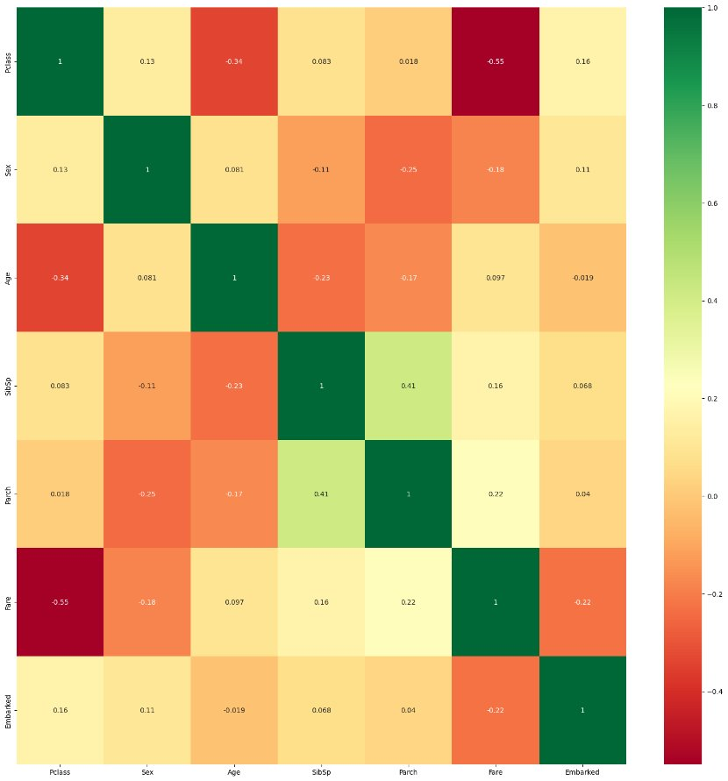
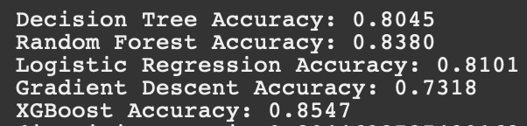
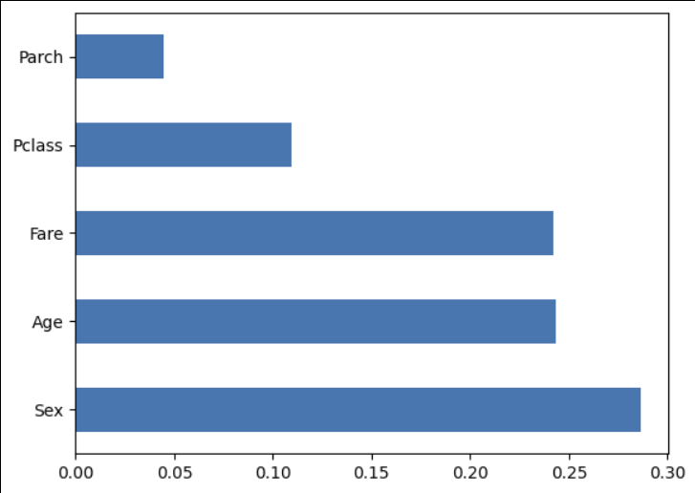
Course Content Relationship (1 / 2)
Initial training scores

Slide 7
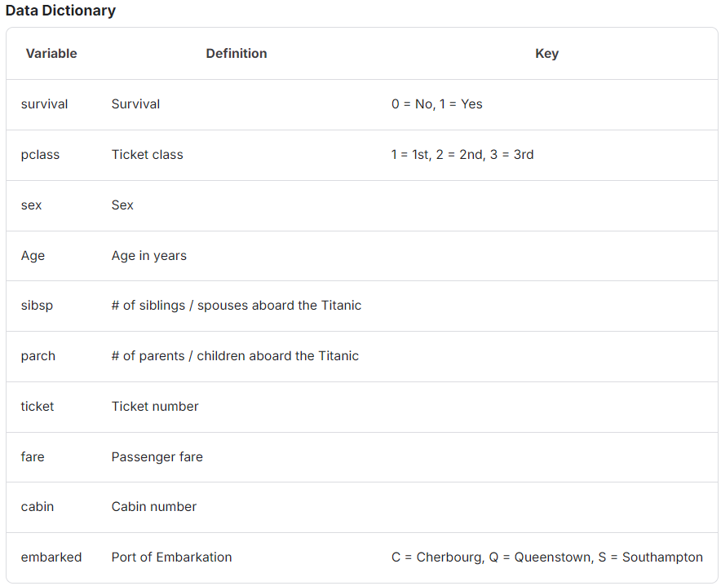
Course Content Relationship (2 / 2)
Binary classifier
Scikitlearn’s impute and preprocessing libraries
Models for consideration: Naive Bayes, Logistic Regression, K-Nearest Neighbours, Support Vector Machine, Decision Tree, Random Forest ,Voting Classification, XGBoost, Gradient Descent, Deep Learning with a neuronal network
Feature Engineering:
Justin: categorizing Age, combining sibsp and parch categorizing into different size families, look into fare and pclass
Model Evaluation Metrics:
Jakob: determining which model(s) to commit to

Slide 8
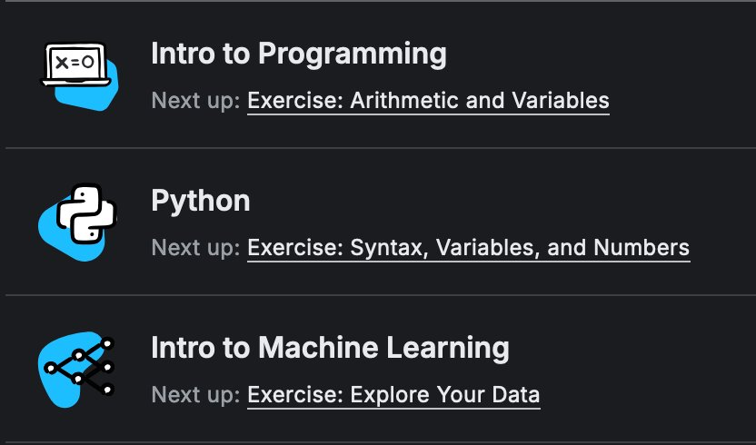
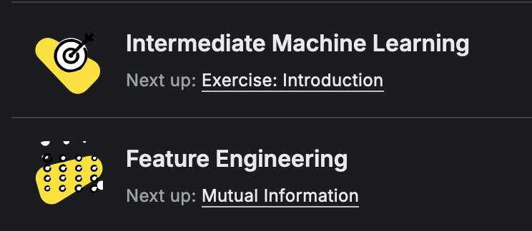
KAGGLE COURSES
Completed
Upcoming

Slide 9
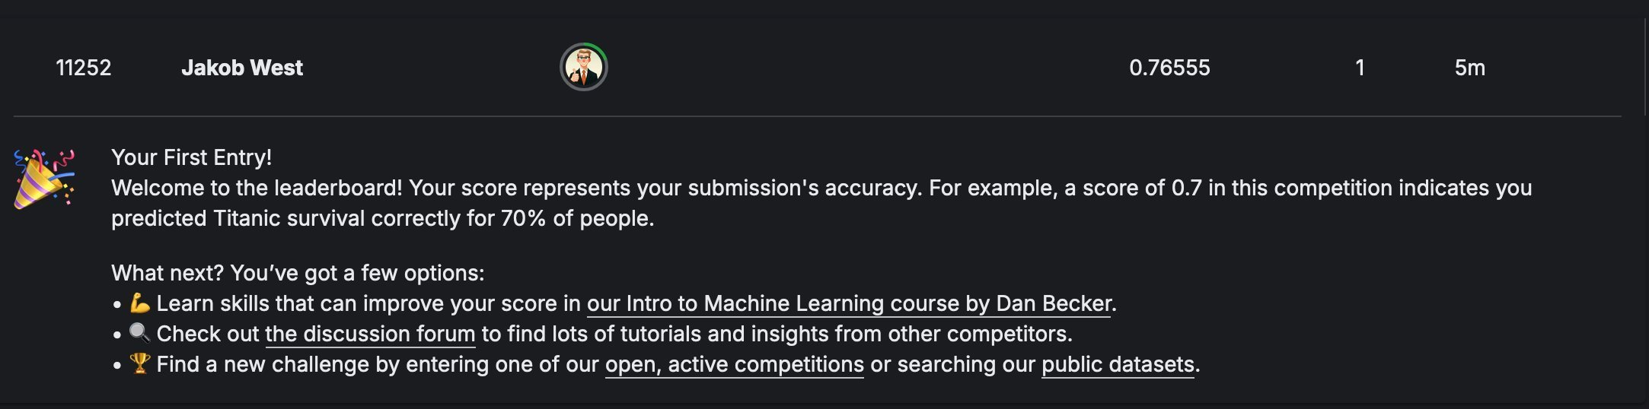
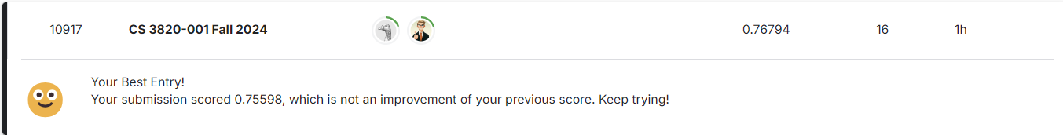
Project Summary & Conclusion
Current accuracy score of .76794
Goal accuracy score of .80, which would place us into the top 800 on Kaggle.com

Slide 10
Timeline
Week - 10/28 - 11/03 --> Monday 10/28, half-way presentation; Feature Engineering Kaggle Course
Week - 11/04 - 11/10 --> Apply feature engineering techniques; optimizing correlation matrix
Week - 11/11 - 11/17 --> Intermediate Machine Learning Kaggle Course; application of course
Week - 11/18 - 11/24 --> evaluation / performance metrics; finalize models and submissions
Week - 11/25 - 12/01 --> Thanksgiving; time with family and break from school; so necessary
Week - 12/02 - 12/08 --> Wednesday, 12/04, final presentation; turn in final deliverable

Slide 11
QUESTIONS?
References:
Kaggle. (n.d.). Titanic: Machine Learning from Disaster. Retrieved from https://www.kaggle.com/c/titanic

